Slide 1
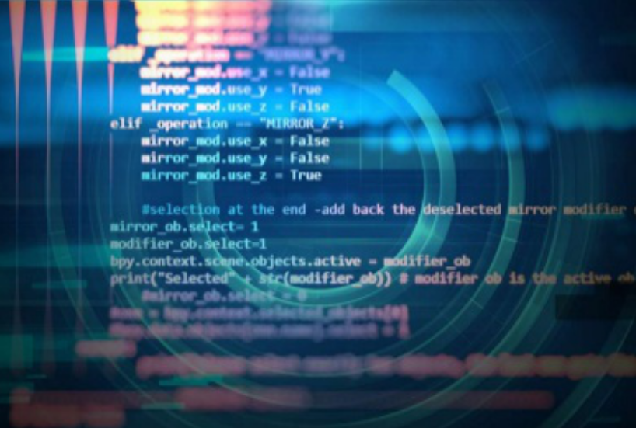
Object – Oriented Programming
Iksan Bukhori, M.Phil.

Slide 2
Topic 1I: Basics of Python Programming
Most Materials in this slide are taken from a video by freecodecamp.org channel:
Learn Python - Full Course for Beginners [Tutorial]

Slide 3
Variables and Data Types
Data Types
String
Numerical Data
Boolean
etc.
integer
float
etc.
True
False

Slide 4
Working with Strings
print()
Escape Character and Newline
Printing plain text using variables
Text Concatenation

Slide 5
Working with Strings: Some Functions for Strings
lower() and upper()
isupper() and islower
Combining the usage of multiple functions
len(…)
Character indexing ([])
index(…)
replace(… , …)

Slide 6
Working with Numbers: Functions for Numbers
Basic Arithmetic (+,-,*,%,…)
Printing number with string conversion
String Concatenation vs Arithmetic Addition
abs(…)
pow(… , …)
max(… , … , ) and min(… , …, )
round(…)
Module import (math)
floor(…) and ceil(…)
sqrt(…)

Slide 7
Getting Input from User
input(…)
String to Number Casting/Conversion

Slide 8
Lists and its functions
What is lists and how to create it
Multiple data types in a list
Print the whole list
Print certain element in the list
Positive and Negative Indexing
Print elements within a range
Modify elements in the list
extend()
append()
insert()
remove() and clear()
pop()
Check if an element is in the list using index()
count()
sort() and reverse()
copy()

Slide 9
Tuples
Tuples vs Lists
Printing element of a tuple
List of Tuples

Slide 10
Function
What is it?
How to define it?
Importance of indentation
Function Calling
Functions with Parameters
Value returning function (return statement)

Slide 11
IF Statement
What is it?
How to write it?
IF statement with Boolean operation
elif
Comparison in IF statement

Slide 12
Dictionaries
Key-value pairs
How to create dictionary
Print value based on key
get() and default value

Slide 13
While loop
What is it
How to write it
Building Guessing Game

Slide 14
For Loop
What is it
How to write it

